Slide 1

Long Reach High School PTSA
Empowering Students • Supporting Staff • Strengthening Our School Community • Building Community Partnerships
ONE REACH.
ONE PURPOSE.
CHECK US OUT • JOIN US • GET INVOLVED
Parent Teacher Student Association Join Us in Making a Difference!

Slide 2





How We Support LRHS
How the PTSA Supports LRHS
LRHS PTSA
Building connection and opportunity across the school
Staff Support
Student Support
Parents & Community
Back to School Staff Breakfast
Prom Support
Educational Speakers & Presentations
Dinners for Parent/Teacher Conferences
Senior Scholarships
Outreach Initiatives (Homewood & ARL)
Holiday Treats & Summer Ice Cream
Street Smarts Driver’s Education
Family Engagement Workshops
Staff Appreciation Week Luncheons
Student Wellbeing & Mental Health
Advocacy for School Resources
Classroom & Teacher Resource Support
SAT/ACT Practice Test Sessions
Parent-Teacher Collaboration Platforms
National PTA Reflections Arts Program

Slide 3








Our Strategic Goals for 2026–2027
Our Strategic Goals For This Year
LRHS PTSA
Four priorities that put students and the LRHS community first
Senior Activities & Scholarship
Prom Support
Supporting our Seniors through expanded PTSA scholarship opportunities and assisting with funding for Senior Breakfast activities
Providing financial support for Prom to ensure a safe, memorable, and affordable celebration
Student Life
Serving Our Community
Boosting school spirit and student well-being by contributing to key events such as the Back to School Block Party, Homecoming, Battle of the Classes, and mental health initiatives
Building an inclusive school culture by extending outreach to all Long Reach families, supporting community resource programs, and strengthening family involvement.

Slide 4





Involvement and Community Partnership
Involvement & Community Partnerships
LRHS PTSA
Donations
Volunteers
Program Partners
Direct financial gifts, food contributions, and prize items for student events and staff appreciation.
Become a Committee Member, volunteer for Prom night, assist with fundraising, or attend monthly meetings.
Collaborations with Street Smarts Driver's Education, Kendra Scott, Backstage Dance Studios, Clothing to Cash Recycling, and local restaurant nights.
Partner With Us To Grow Long Reach High School!

Slide 5



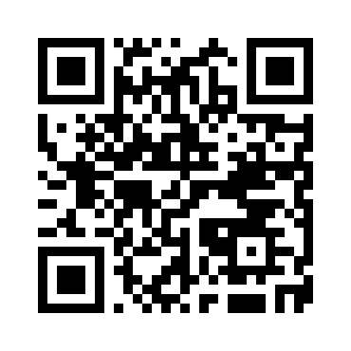



Join Us & Check Us Out!
Check Us Out & Get Connected
LRHS PTSA
Stay informed, join the PTSA and help us make 2026–2027 a great year
Scan to Join the PTSA!
Visit Our Website
Use the link or QR code below to become an active member
Stay updated on events, activities, and PTSA announcements on www.lrhsptsa.org
Email Us
Reach out to PTSA officers for questions & partnerships
Monthly PTSA Meetings
Join parents, teachers, and students in shaping LRHS
Follow Us on Social Media
lrhs-ptsa.givebacks.com/shop
Connect with Long Reach High School PTSA on Instagram and Facebook
LET’S GROW LONG REACH TOGETHER.

